Slide 1

Computer Graphics
Color Models

Slide 2

Achromatic/Grayscale
Used as a synonym for ‘black and white’
All RGB values are equal (r=g=b) for Achromatic
Different intensities of grey
Lack of hue (pure color), saturation (intensity of a color) and brightness
Only measured using the quantity of light

Slide 3
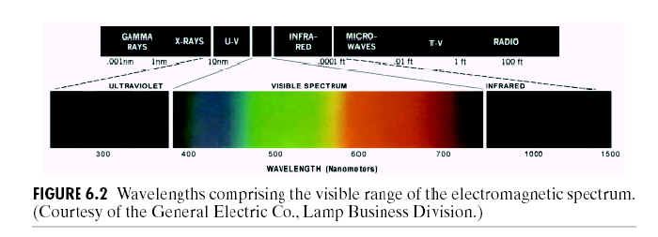
Electromagnetic Spectrum
Visible light: a narrow band of electromagnetic radiation →
380nm (blue) - 780nm (red)

Slide 4
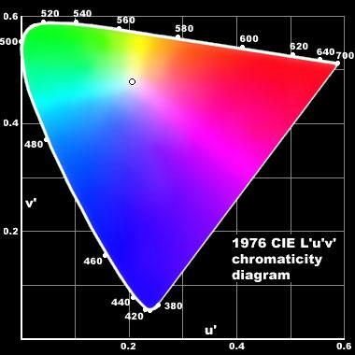
Chromaticity Diagram

Slide 5
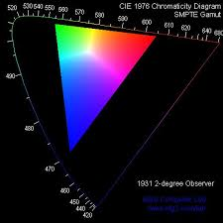
Color Gamut
The color gamut describes a range of colors within the spectrum of colors, or a color space, that can be reproduced on an output device. Depending on how wide the gamut is, every screen will display different quantities of color.

Slide 6
Color Systems
The purpose of a color model (also called Color Space or Color System) is to facilitate the specification of colors in some standard way.
A color model is a specification of a coordinate system and a subspace within that system where each color is represented by a single point.
Available color systems are dependent on the medium on which one is working.

Slide 7
Different Color Models
RGB (Red, Green, Blue)
CMY (Cyan, Magenta, Yellow)
HSV (Hue, Saturation, Value)
HLS (Hue, Lightness, Saturation)
YIQ (Luminance,In phase, Quadrature)
YUV (Y' stands for the lumaY' stands for the luma component (the brightness) and U and V are the chrominance (color) components )

Slide 8
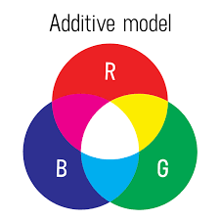
Additive Color
Additive color mixing begins with black and ends with white; as more color is added, the result is lighter and tends to white. If we are working on a computer, the colors we see on the screen are created with light using the additive color method.
RGB color model applies Additive model

Slide 9
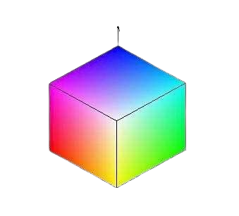
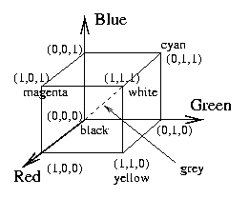
RGB Model
Model based on Cartesian Coordinate System
RGB 24 bit (8-bit per channel) color cube

Slide 10
RGB Model
Primary colors are red, green, and blue.
The RGB model is usually represented by a unit cube with one corner located at the origin of a three-dimensional color coordinate system, the axes being labeled R, G, B, and having a range of values [0, 1].
The origin (0, 0, 0) is considered black and the diagonally opposite corner (1, 1, 1) is called white. The line joining black to white represents a gray scale and has R=G=B.
This is the model used for active displays such as television and computer screens.

Slide 11

Subtractive Color
Subtractive color mixing means that one begins with white and ends with black; as one adds color, the result gets darker and tends to be black. When we mix colors using paint, or through the printing process, we are using the subtractive color method.
CMY color model applies Subtractive model

Slide 12
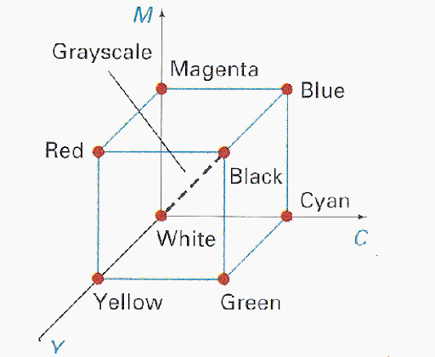
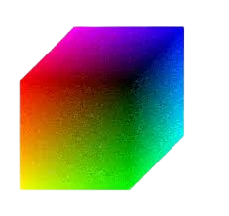
CMY Model
Model based on Cartesian Coordinate System
CMY color cube

Slide 13
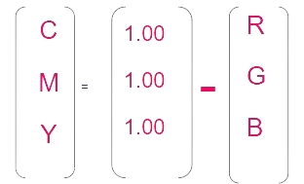
CMY Model
Cyan, magenta, and yellow are the secondary colors with respect to the primary colors of red, green, and blue. However, in this subtractive model, they are the primary colors and red, green, and blue, are the secondaries.
In this model, colors are formed by subtraction, where adding different pigments causes various colors not to be reflected and thus not to be seen. Here, white is the absence of colors, and black is the sum of all of them.
Most devices that deposit color pigments on paper (such as Color Printers and Copiers) requires CMY data input or perform RGB to CMY conversion internally.

Slide 14
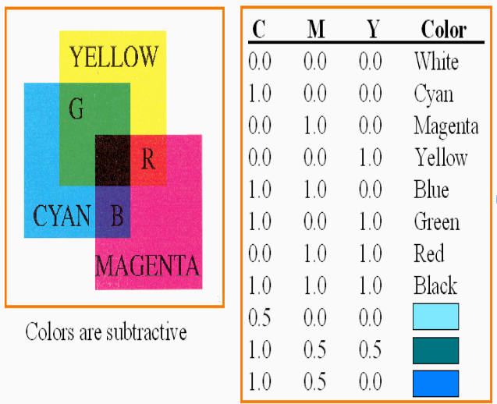
CMYK Model
Equal amounts of pigment primaries (Cyan, Magenta and Yellow) should produce Black. In practice combining these colors for printing produces a “Muddy-Black” color. So in order to produce “True-Black” a fourth color “Black” is added giving rise to CMYK model.

Slide 15
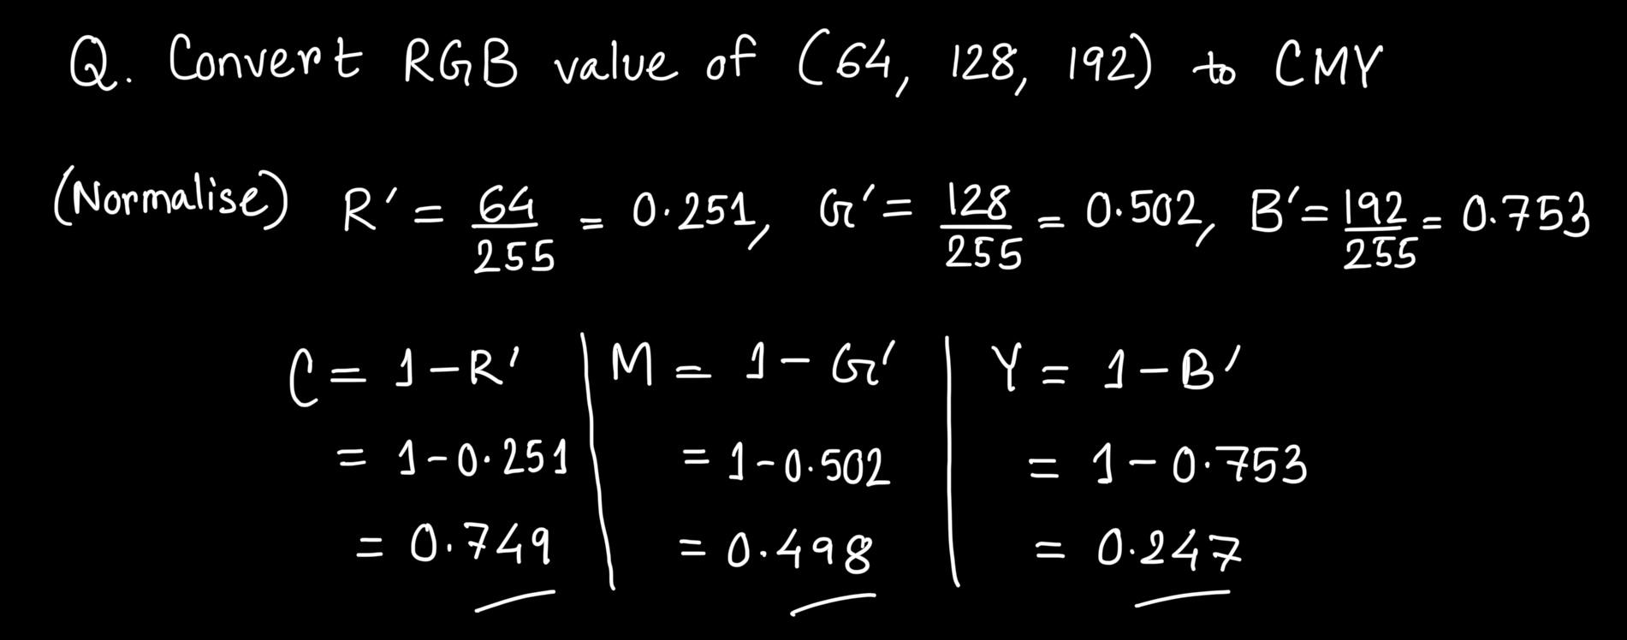
RGB - CMY Conversion
RGB 8-bit per channel System

Slide 16
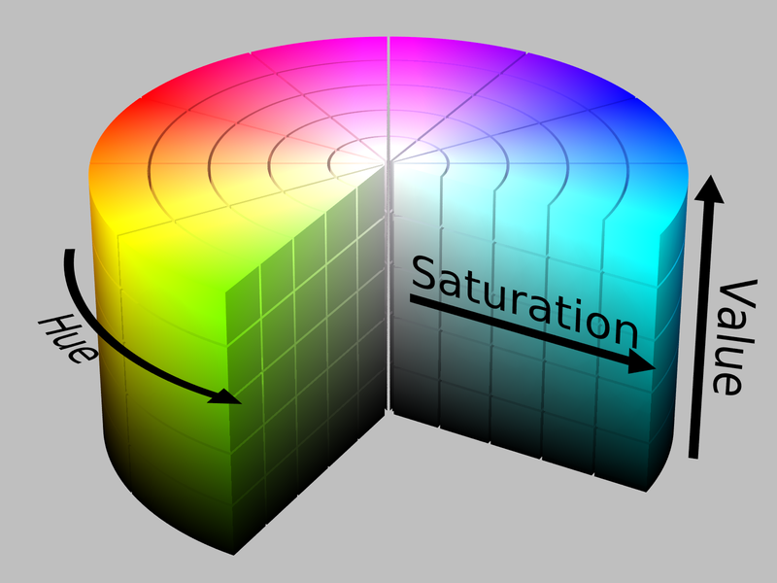
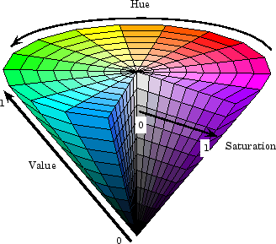
HSV/HSB Color Model
Check this link
Notes:
https://programmingdesignsystems.com/color/color-models-and-color-spaces/index.html

Slide 17
HSV Color Model
Hue (color wheel/dominant color)
Wavelength of the pure colour observed in the signal.
The cone represents the HSV model, the hue represents different colours in different angle ranges.
More than 400 hues can be seen by the human eye.
Saturation (percentage/purity of the color)
Inverse of the quantity of “white” present in the signal. A pure colour has 100% saturation, the white and grey have 0% saturation.
About 20 saturation levels are visible per hue.
How far the color is from equal intensity grey
Range [0,1]
Value (brightness or intensity of a color)
Distinguishes the grey levels. Its value lies in percentages from 0 to 100. 0 is black and 1 is the brightest and reveals the colour.
Value describes how light or dark a color appears. Eg. A bright yellow has a high value. A dark brown or deep blue has a low value.
Helps in generating shading or lighting effects in graphics.

Slide 18
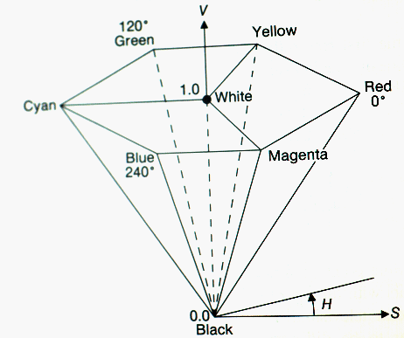
HSV Color Model

Slide 19

RGB to HSV Conversion
Divide r, g, b by 255 (if the scale is 0-255, otherwise skip)
Compute cmax, cmin, difference
Saturation computation :
if cmax = 0, then s = 0,
if cmax does not equal 0 then compute s = (diff/cmax)*100
Hue calculation :
if s equal 0, then h = 0 [h = undefined]
else if cmax equal r then compute h = (g – b) / diff
else if cmax equal g then compute h = 2 + ((b – r) / diff)
else if cmax equal b then compute h = 4 + ((r – g) / diff)
h = h * 60
if h<0 → h = h + 360
5. Value Computation: v = cmax*100
Notes:
https://www.sciencedirect.com/science/article/abs/pii/S0045790615002827

Slide 20
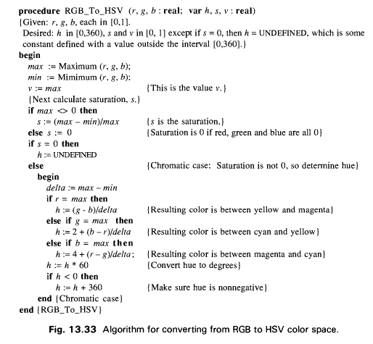
RGB to HSV Conversion (Algorithm)

Slide 21
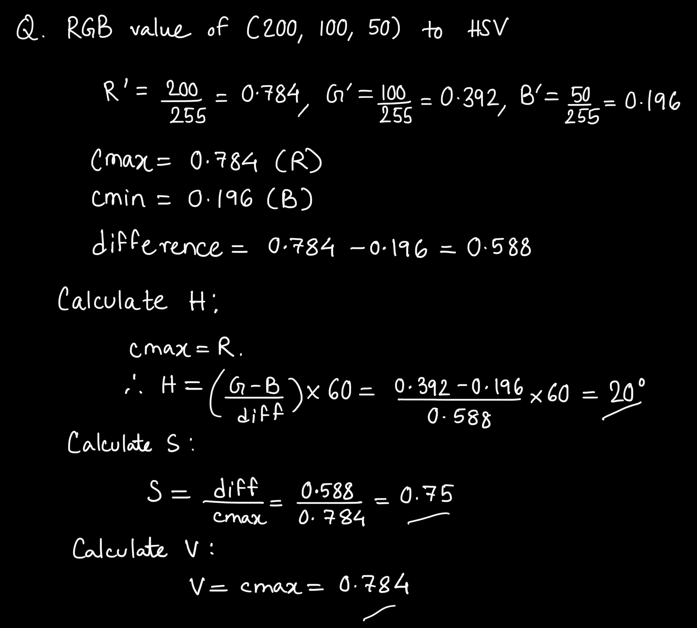
RGB to HSV Conversion Example
RGB 8-bit per channel System

Slide 22
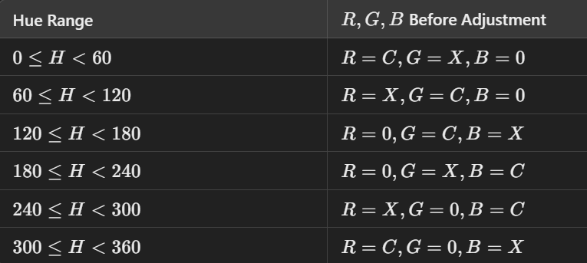
HSV to RGB Conversion
1. Calculate Chromatic Component (C )
The chroma C, represents the difference between the maximum and minimum RGB components:
C = V × S 2. Find the Intermediate Value (X)
The value X is a scaled component based on the current segment of the hue:
X = C × ( 1 − ∣ (H/60 mod 2 ) − 1 ∣ ) 3. Calculate the Adjustment (m)
The adjustment m, shifts the RGB values to match the value V (the maximum component):
m = V − C 4. Assign RGB Values Based on Hue Segment
The hue (H ) determines the sequence of R,G,B. Divide H into 6 segments (0º−360º):
5. Adjustment
Adjust the RGB values to match the original value (V):
R’=(R+m), G’=(G+m), B’=(B+m)
Notes:
C: Represents the strongest (maximum) RGB component in the segment.
X: Represents the secondary color intensity (from blending the two adjacent hues).
0: Represents the weakest RGB component in the segment.

Slide 23
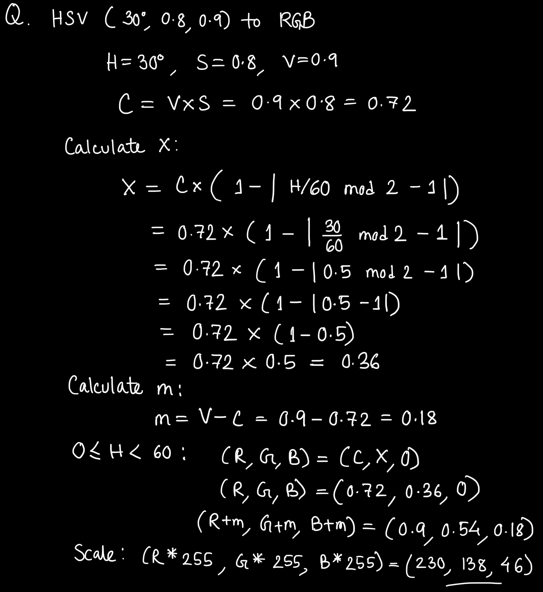
HSV to RGB Conversion Example

Slide 24
HSV Color Model Application
The HSV model is widely used in computer graphics for intuitive color selection in tools like color pickers and gradient design.
It aids in image processing tasks such as color-based filtering, segmentation, and thresholding.
In shading, lighting, and special effects, HSV simplifies dynamic adjustments and smooth color transitions.
It's critical for color grading in video editing and data visualization, mapping values to colors effectively.
Additionally, HSV is essential in gaming, AR/VR, and AI applications, where it supports object highlighting, procedural content generation, and feature extraction.

Slide 25
HLS Color Model
HLS (Hue, Lightness, Saturation) – A cylindrical color model.
a. Hue: Angle on the color wheel (e.g., 0° = red, 120° = green, 240° = blue). b. Lightness: 0=black,1=white,0.5=pure color. c. Saturation: 0=gray,1=fully vivid color
Application: Image editing, color pickers, and design tools. Useful for adjusting brightness without altering color hue.

Slide 26
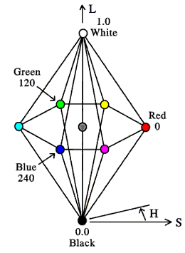
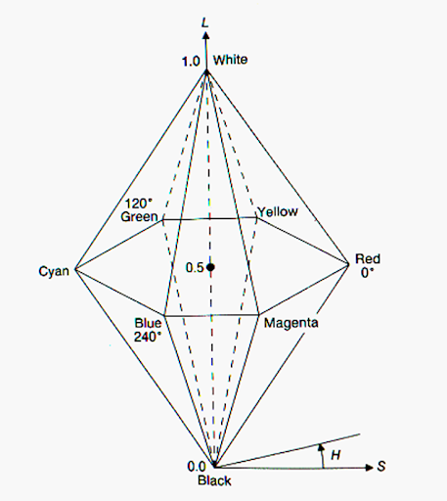
HLS Color Model

Slide 27
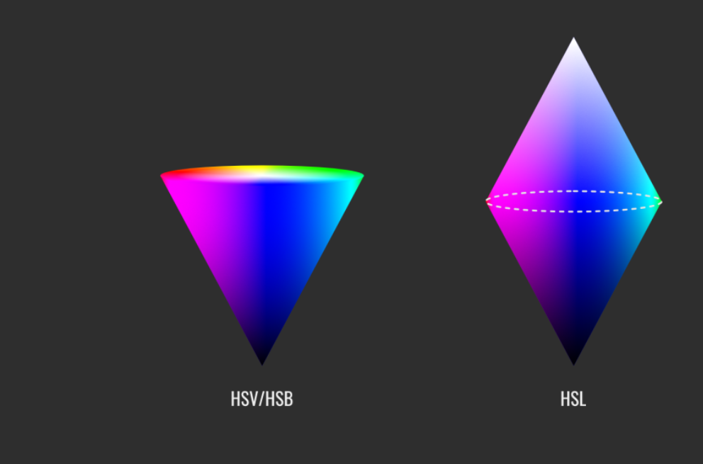
HSV - HLS Comparison

Slide 28
RGB to HLS Conversion
Normalise
Compute cmax, cmin, difference
L = (cmax + cmin) / 2
Hue calculation :
if diff = 0, then h = 0
if cmax equal r then compute H = (g – b) / diff
if cmax equal g then compute H = 2 + (b – r) / diff
if cmax equal b then compute H = 4 + (r – g) / diff
H = H * 60
if H < 0 → H = H + 360
Saturation computation :
if diff = 0, then S = 0
S = diff/(cmax + cmin) if L <= 0.5
S = diff/[2- (cmax + cmin)] if L > 0.5

Slide 29
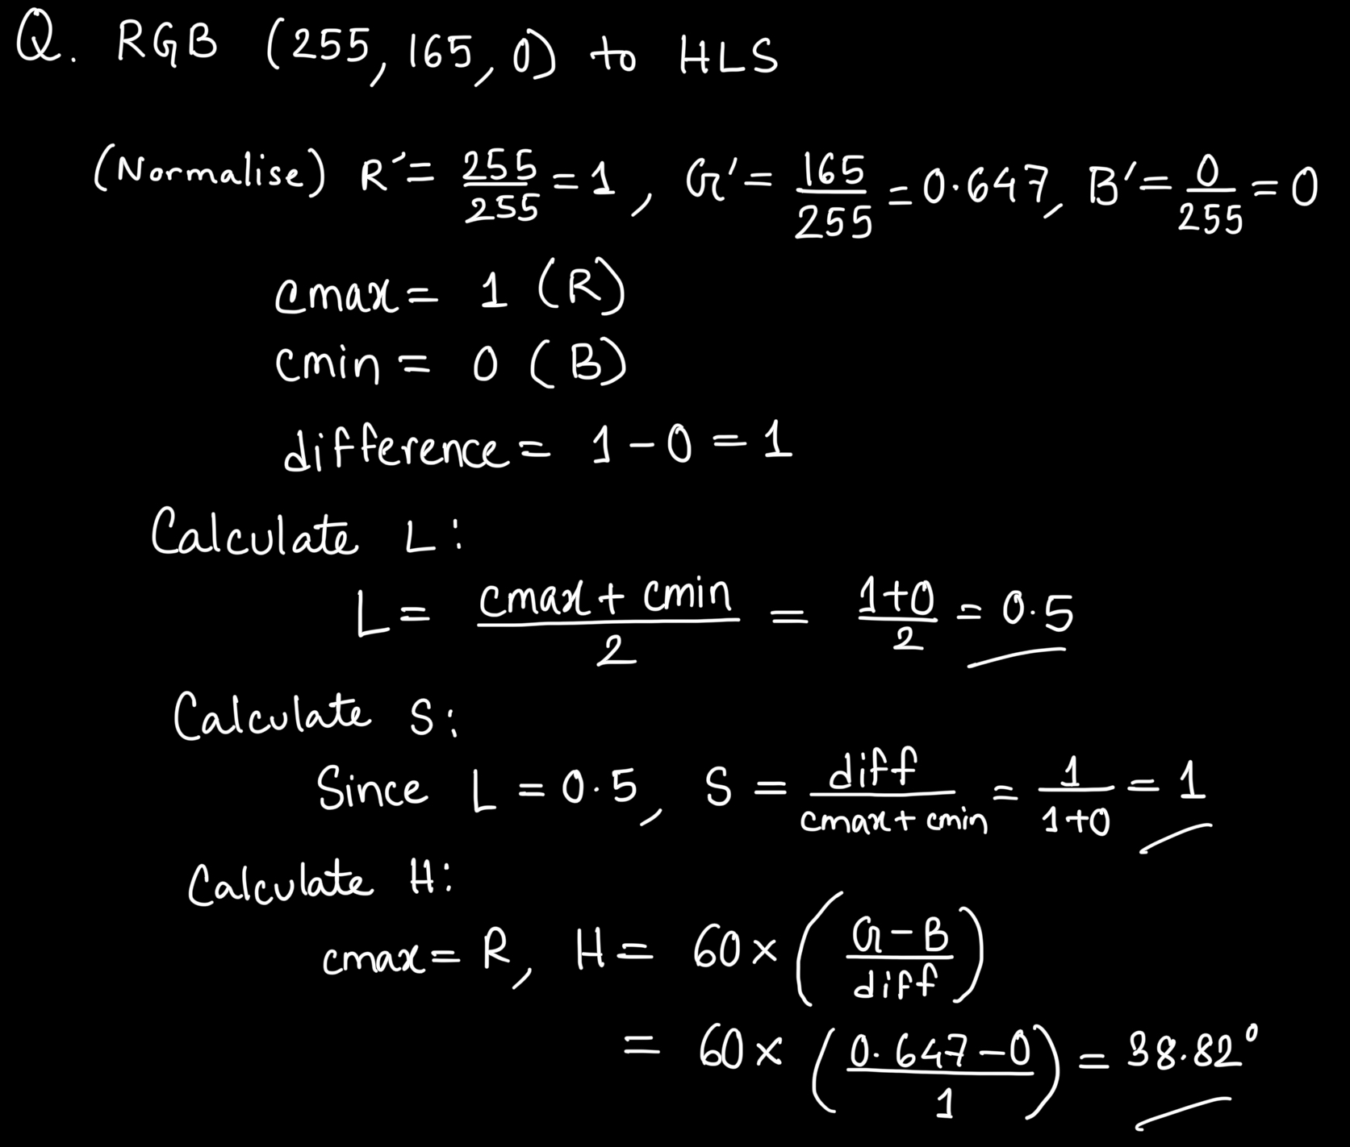
RGB to HLS Conversion Example

Slide 30
Exercise
Convert the following colors:
 | R | G | B | Hue | Sat. | Brightness/ Value | C | M | Y
1 | 0.25 | 0.30 | 1.0 | 236° | 75% | 100% | 0.75 | 0.7 | 0.0
2 | 0.01 | 1.00 | 0.99 | ? | ? | ? | ? | ? | ?
3 | 1.0 | 0.11 | 0.01 | ? | ? | ? | ? | ? | ?
4 | 0.8 | 0.8 | 0.3 | 60° | 62.5% | 80% | 0.2 | 0.2 | 0.7
5 | ? | ? | ? | ? | ? | ? | 0.1 | 0.3 | 0.1

Slide 31
Reference
Computer Graphics: Principles and Practice: John F. Hughes, James D. Foley, Andries van Dam, Steven K. Feiner (2nd Edition)
Chapter: 13.1(before 13.1.1), 13.3.1, 13.3.2, 13.3.4, 13.3.5
Website Links:
Link 1
Link 2
Link 3

